Slide 1
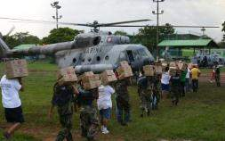
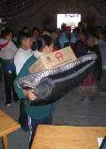
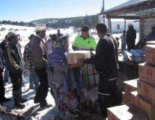
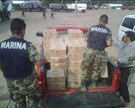
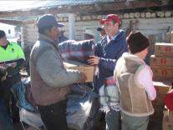

The Mexican Disaster
Risk Financing Strategy
Rubem Hofliger Topete
Natural Disasters Fund Director General
Notes:
1

Slide 2
Background
In attention to the government’s concerning to increase their capacity to attend the damaged caused by natural phenomena without altering the public finances, by 1996 the Natural Disasters Fund (FONDEN) was created.
Although with the FONDEN constitution the trouble related to avoid a lead off on the regular programs resources was in a way solved, there were not a legal regulation which provides the correct control and transparency in the money application; therefore in 1999 the first FONDEN rules were issued, which has had over the years many substantial modifications to improve its efficiency.
In 2002 and 2003, two preventive funds (FOPREDEN and FIPREDEN) were created and in 2011 they were merged in one new and strong FOPREDEN, in order to collect the benefits of both and to strengthen their capacity and enhance it’s resources for DRR.
Reactive
Preventive

Slide 3
Disaster Time Line
Scope of Federal FONDEN reinsurance programme
Disaster Prevention
(before)
Emergency and/or Disaster
(meanwhile and afterwards)
FOPREDEN
FONDEN
Programmed actions
Urgent actions
Emergency Fund
reconstruction Fund
Months to years
Days To Weeks
Hours, Days to Weeks
Days, Weeks to Months
How it is detonated?
How it is detonated?
EMERGENCY
DECLARATION
DISASTER
DECLARATION
Occurrence of the phenomenon
AID SUPPLIES FOR THE POPULATION
RECONSTRUCTION RESOURCES
All federal plans and programs are activated in order to attend the disaster

Slide 4

FONDEN
Integration
  The FONDEN program.- budget line within the Federal Budgetary Expenses of every year and works mostly as a cash transfer to the FONDEN Trust;
  The FONDEN Trust.- financial tool which finances: i) the reconstruction of the public infrastructure and housing of low income population; ii) the acquisition of risk transfer instruments to protect it’s patrimony, and iii) supports for the states to develop a risk transfer strategy for their assets;
  The Immediate Fund for humanitarian aid.- which is financed by the FONDEN program and/or the FONDEN trust indistinctly;
Funding mechanism: Articles 19 and 37 of the Federal Budget Law
Reconstruction
Risk transfer instruments
Supports to develop a risk
transfer strategy for local assets
Aid supplies
acquisition

Slide 5
Risk analysis and risk transfer instruments
Since 2007, the Mexican government has worked on the creation of databases and risk analysis in order to have more technical elements that support the design of risk transfer instruments that complement FONDEN.
The results of this effort allowed to obtain two essential elements to design risk transfer mechanisms:
1. A database of main public assets and infrastructure including aspects like geographical location, building characteristics and replacement cost.
  The first stage focused on the main assets financed by FONDEN for the reconstruction: roads, hospitals, schools and water infrastructure and housing for low-income population.
2. An analysis of the main hydrometeorological and geological risks that affect the Mexican territory in order to determine the vulnerability of the infrastructure.
Notes:
5
5
5

Slide 6
Cat Bond
Multi Cat Mexico is a catastrophic bond that provides protection against earthquake and hurricane risks for a three year period.
Multi Cat 2012 represents significant improvements with respect to Cat Mex 2006 and 2009:
  The mechanism expands coverage to Pacific and Atlantic hurricanes.
  For the (continued) earthquake risk:
    the level of triggers were reduced to cover more events.
    the coverage zones were extended in order to protect a larger population.
An insurance claim payment will be triggered with an official state of emergency declaration issued by the Ministry of Interior and an event occurs with the specific triggers.
Notes:
In first place, the member countries interested were: Mexico, Peru, Chile, Turkey, Indonesia, Greece and Colombia.

Slide 7
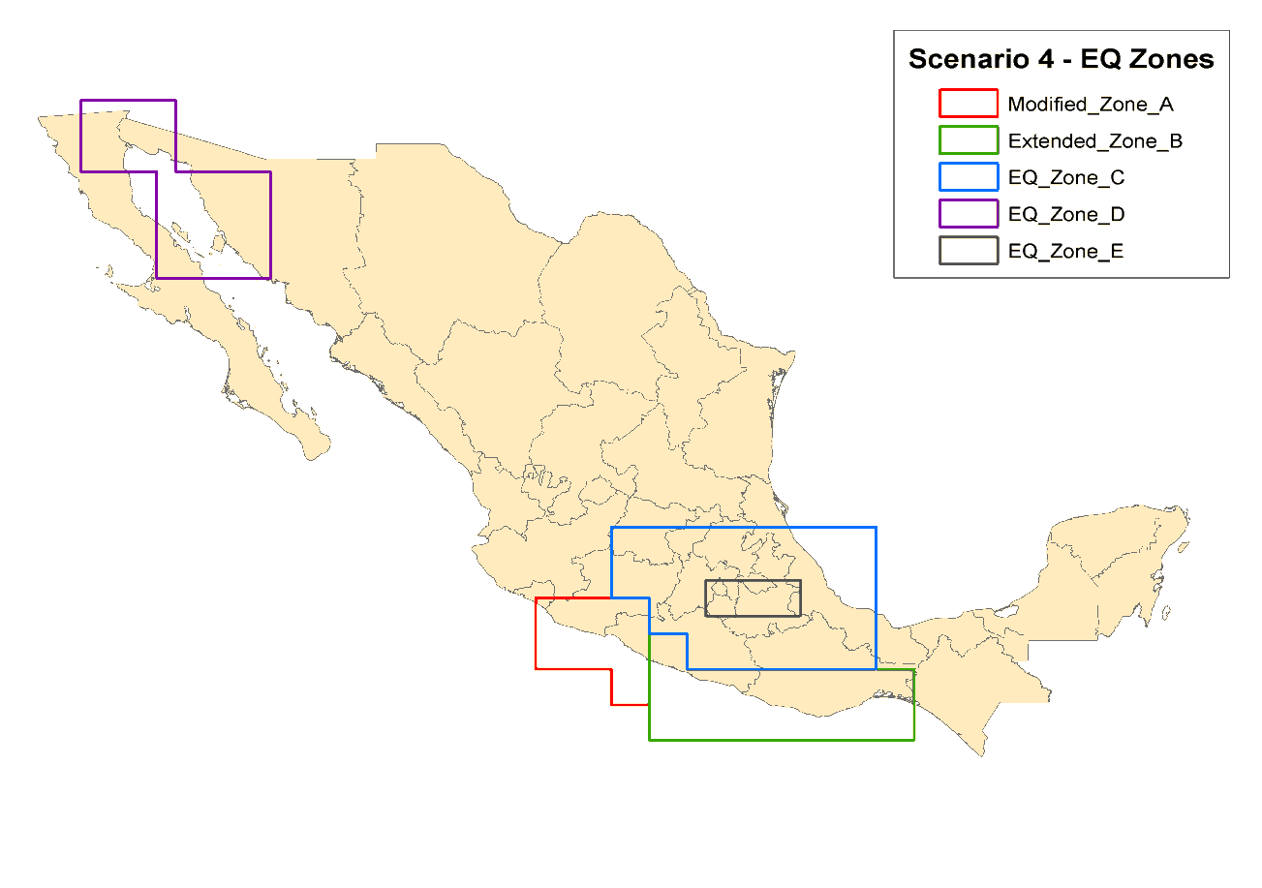
“MULTI-CAT
MEX 2012”
This instrument has a 315 million dollars coverage:
  1) 140 MD for earthquakes;
  2) 100 MD for hurricanes coming from the Pacific Ocean, and
  3) 75 MD for hurricanes coming from the Atlantic Ocean and the Gulf of Mexico.
Earthquake structure
Insurance coverage
140 million dollars
Conditions
Zone | Magnitude | Depth
Zone A | >= 7.9 | <= 200 km
Ext Zone B | >= 8.1 | <= 200 km
Zone C | >= 7.4 | <= 70 km
Zone D | >= 7.6 | <= 200 km
Mod Zone E | >= 7.0 | <= 80 km

Slide 8
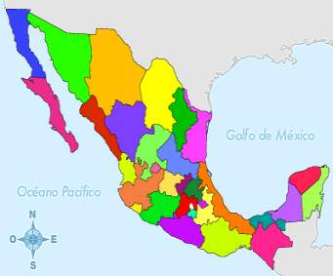
“MULTI-CAT
MEX 2012”
Hurricane structure
Atlantic Insurance Coverage
50 million dollars
Pacific Insurance Coverage
100 million dollars
120°0’0’’W
110°0’0’’W
100°0’0’’W
90°0’0’’W
120°0’0’’W
110°0’0’’W
100°0’0’’W
90°0’0’’W
Class B Notes
Zone1
Zone 2
Scenario 4- Pacific Hurricane Zone
Modified_Pacific_coast
30°0’0’’ N
30°0’0’’ N
30°0’0’’ N
30°0’0’’ N
20°0’0’’ N
20°0’0’’ N
20°0’0’’ N
20°0’0’’ N
10°0’0’’ N
10°0’0’’ N
10°0’0’’ N
10°0’0’’ N
120°0’0’’W
110°0’0’’W
100°0’0’’W
90°0’0’’W
120°0’0’’W
110°0’0’’W
100°0’0’’W
90°0’0’’W
Conditions
Zone | Central Pressure
Yucatán | <= 920 mbar Category 5
Tamaulipas | <= 920 mbar Category 5
Conditions
Zone | Central Pressure | Insurance indemnity
Extended Pacific | >920 mbar y <= 932 mbar Category 4 | 50%
Extended Pacific | <= 920 mbar Category 5 | 100%

Slide 9
FONDEN insurance coverage 2012
With the same database and risk analysis done, Mexico developed a risk transfer scheme to cover FONDEN in excess of 1 billion dollars.
FONDEN
Coverage 440 million dollars
FONDEN Retention Excludes Federal agencies primary insurance policies: SSA, SEP, CONAGUA
New coverage advantages
    We manage to maintain the 1 billion dollars deductible in order to increase the coverage from 400 million dollars to 440 million dollars.
    The claims protocol improved significantly since we convinced the market to accept the FONDEN damage assessment procedure as a key element to the adjustment losses of the insurance coverage.
    We achieved a higher interest of the reinsurance market (over 40 reinsurance companies vs 32 from last year)
1.44 bd
1 bd
0 mdp
9
Notes:
9

Slide 10
Conclusions
1. We must continue promoting legal reforms to incorporate the disaster risk management concept as a national public policy in all national plans, programs and projects regarding public and private infrastructure in our country, in order to achieve that the investment be applied according to a permanent risk reduction strategy.
2. We must keep fortifying the financial instruments for the prevention of natural disasters, until we obtain the balance between the cost to attend the disasters and the investment applied in prevention and disaster risk reduction;
3. We need to conclude the transit from an intervention of the authorities based on the disaster as the center of all the actions, to other sustained in the analysis and understanding of its generator that is the presence of the risk, and
4. Manage to accomplish a complete risk transfer administration of the natural disasters to which Mexico are exposed, looking for its diversification between the different financial instruments available in the international market, so before the presence of catastrophic disasters, the national public finances are not affected and therefore our economic stability and development.
Notes:
10

